Slide 1
GITHUB ORGANIZATION

Slide 2
Contents
Introduction
Goals Of Implementation
Github Limitations
Demo
GitHub Organization
Github Repository

Slide 3
Introduction
GitHub is a service provided by Microsoft that many software developers use for source code storage, management, sharing, and version control. It has become stable in the software and IT field. Not only does it help independent developers, but also companies in creating robust repositories with efficient processes in place.

Slide 4
Goals Of Implementation
Basically, we can manage multiple projects with many teams and organizations. For example, an organization may have .NET projects, Java projects, Open Source projects, Database projects. So, you can create multiple projects in one organization and distribute them with multiple teams.
Easier visibility over progress
Simpler access to resources between members
Proper version control to maintain code integrity and prevent conflict between developer commits

Slide 5
GitHub Organization
An organization in GitHub is meant to centralize all your group/business’s resources and isolate them from the outside.
Member: Members can see all other members and can be granted access to repositories. They can create teams and repositories.
Owner: Owners have full administrative rights to the organization and have complete access to all repositories and teams.
Outside Collaborators:An Outside collaborator is a person who isn't explicitly a member of your organization, but who has Read, or Admin permissions to one or more repositories of your organization.

Slide 6
Github Repository
A repository contains all of your project's files and each file's revision history.
You can restrict who has access to a repository by choosing a repository's visibility: public or private. Organization owners always have access to every repository created in an organization.
Public: Public repositories are accessible to everyone on the internet.
Private: Private repositories are only accessible to you, people you explicitly share access with, and, for organization repositories, certain organization members

Slide 7
Github Limitations
Security Level:
There is still presence of some insecurity and risk in GitHub software. This is due to the reason that it is cloud-based. This is why some developers and clients only help prefer to work on their own internal security.
Pricing Policy:
GitHub have features restricted based on our plan. If you have a large group of members, this can be expensive. Yet those who already have a IT group, their servers are better performing with their Git system. It is due to expenses and productivity. Yet a new start-up may face significant challenges. It may be due to day-by-day Git’s pricing has improved.

Slide 8
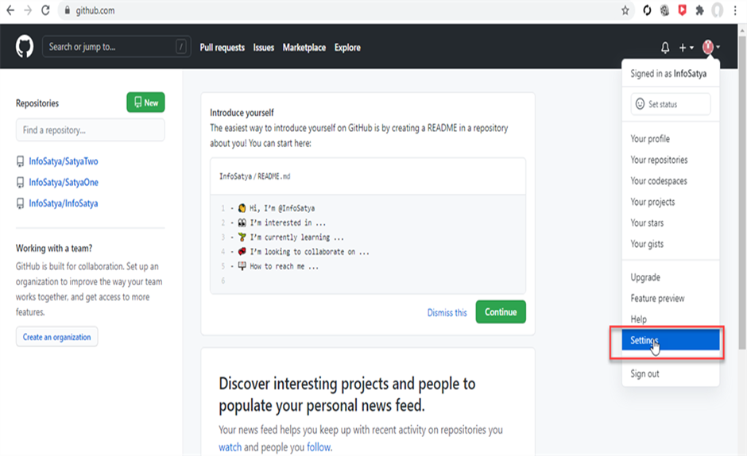
DEMO
GITHUB ORGANIZATION CREATION:

Slide 9
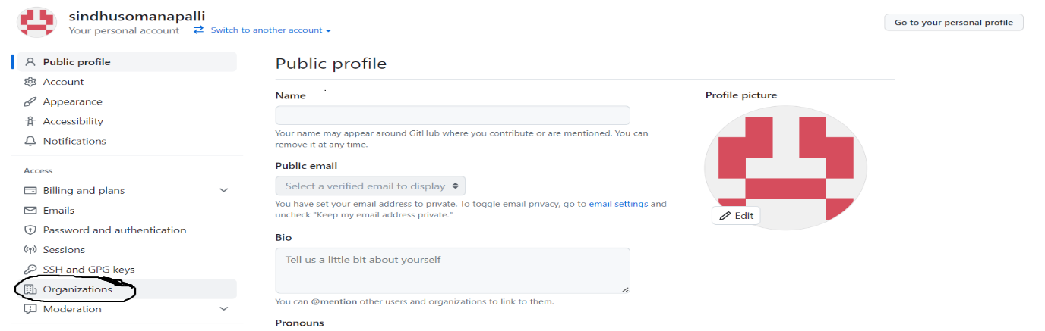

Slide 10
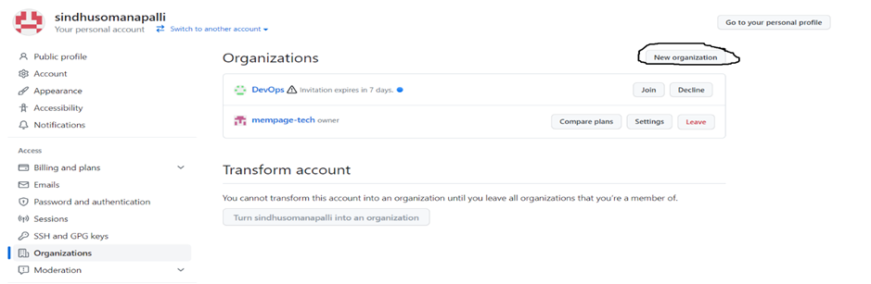

Slide 11
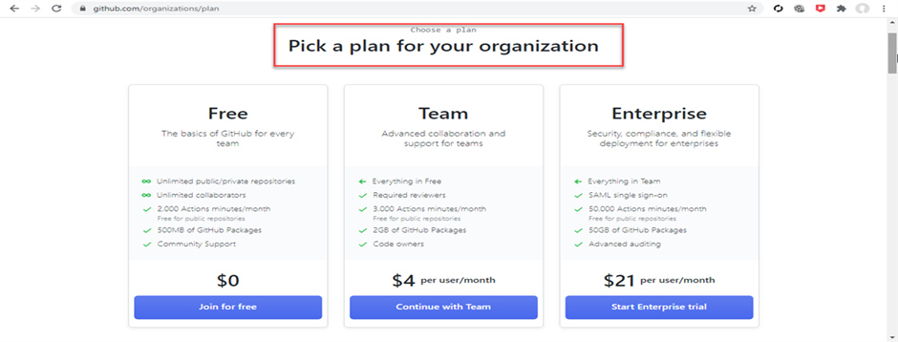

Slide 12
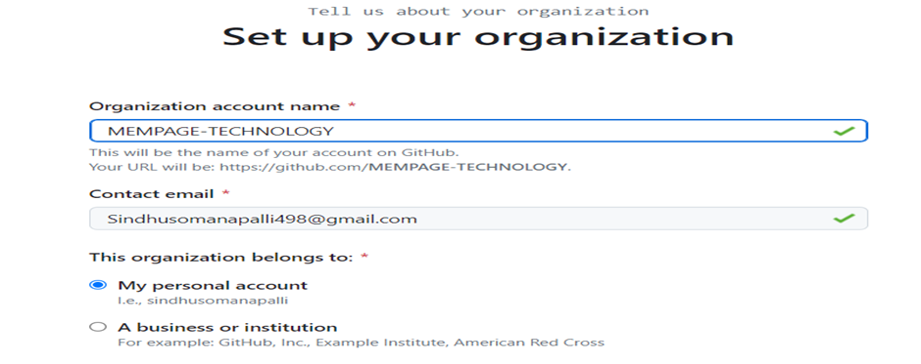

Slide 13
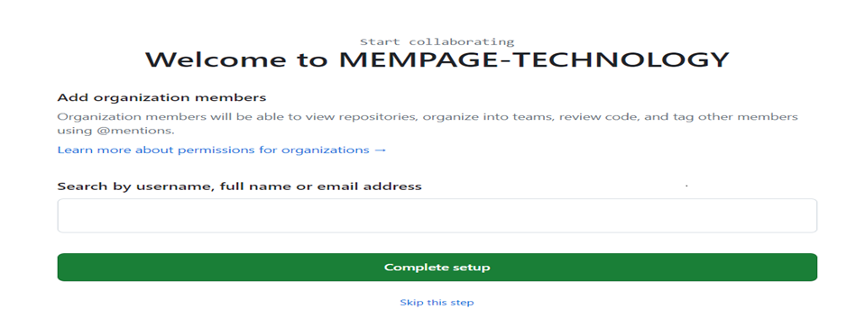

Slide 14
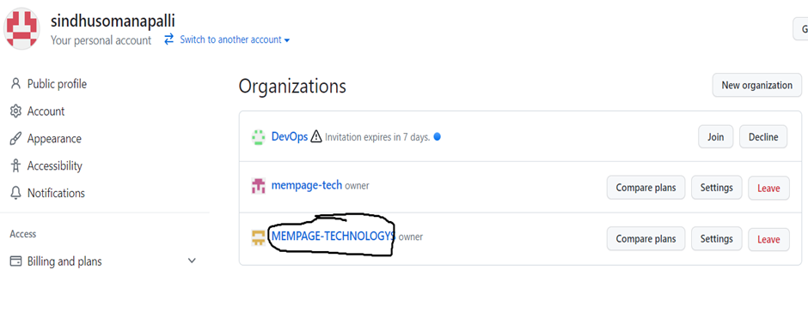

Slide 15
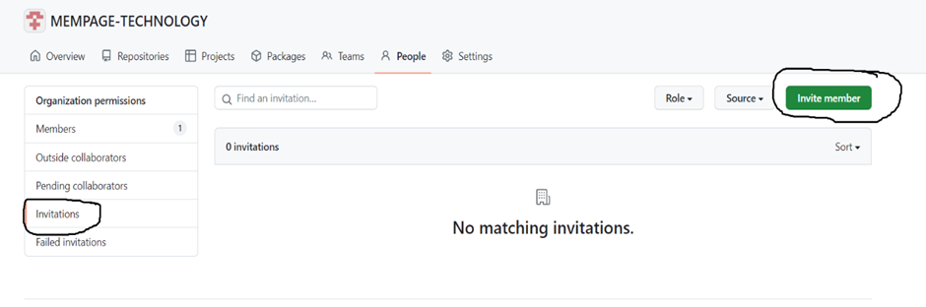
GITHUB ORGANIZATION MEMBER AND OUTSIDE COLLABORATORS CREATION:

Slide 16
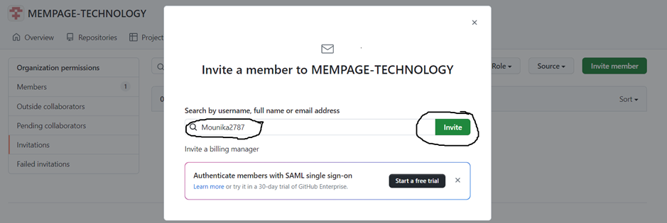

Slide 17
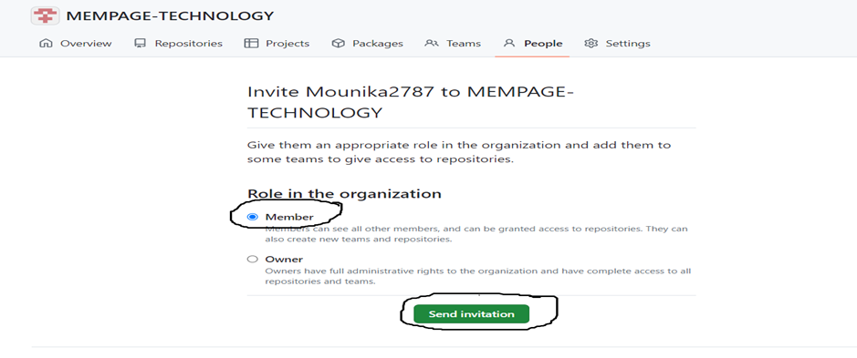

Slide 18


Slide 19


Slide 20
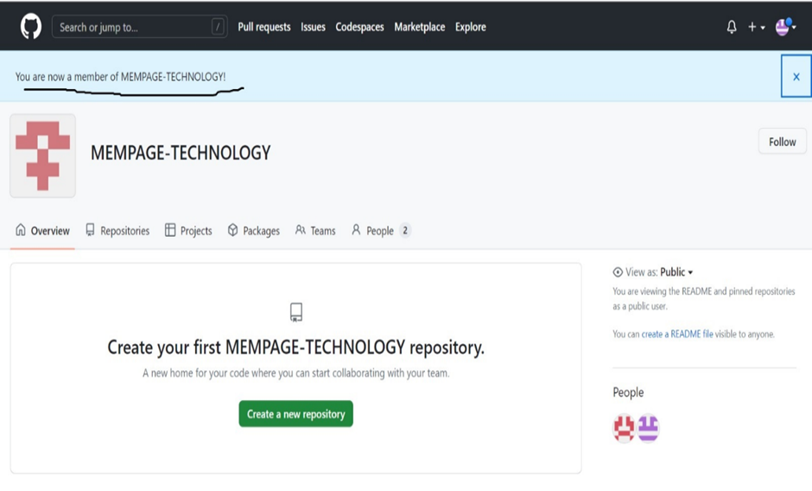

Slide 25
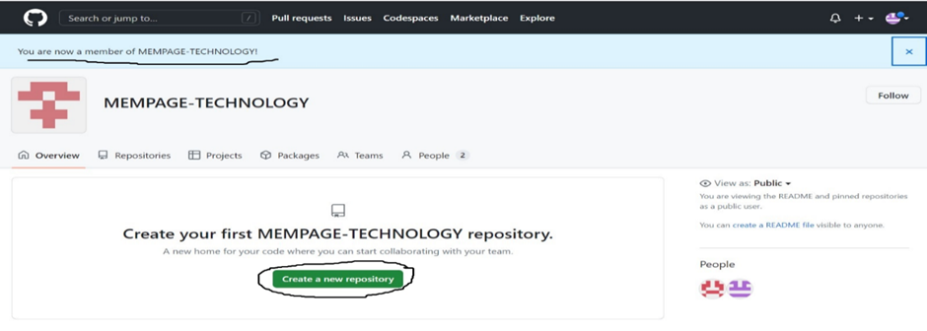
GITHUB REPOSITORY CREATION:

Slide 26
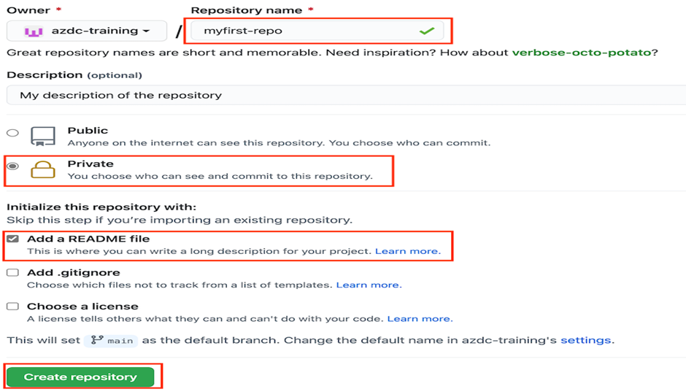

Slide 27
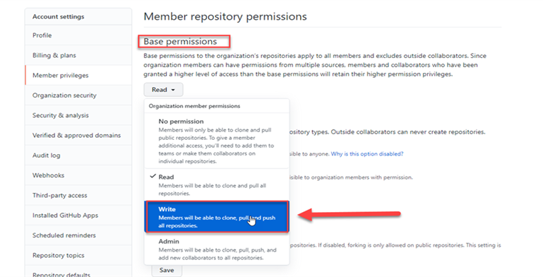
GITHUB MEMBER REPOSITORY PERMISSIONS:

Slide 28
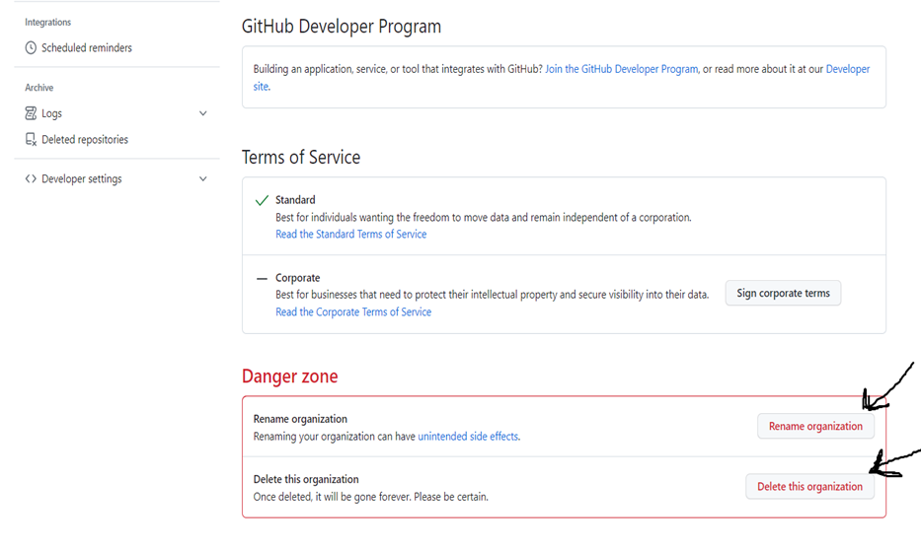
RENAME GITHUB REPOSITORY AND DELETE GITHUB ORGANIZATION:

Slide 29
THANK YOU

